Slide 1

Understanding Web developement

Slide 2
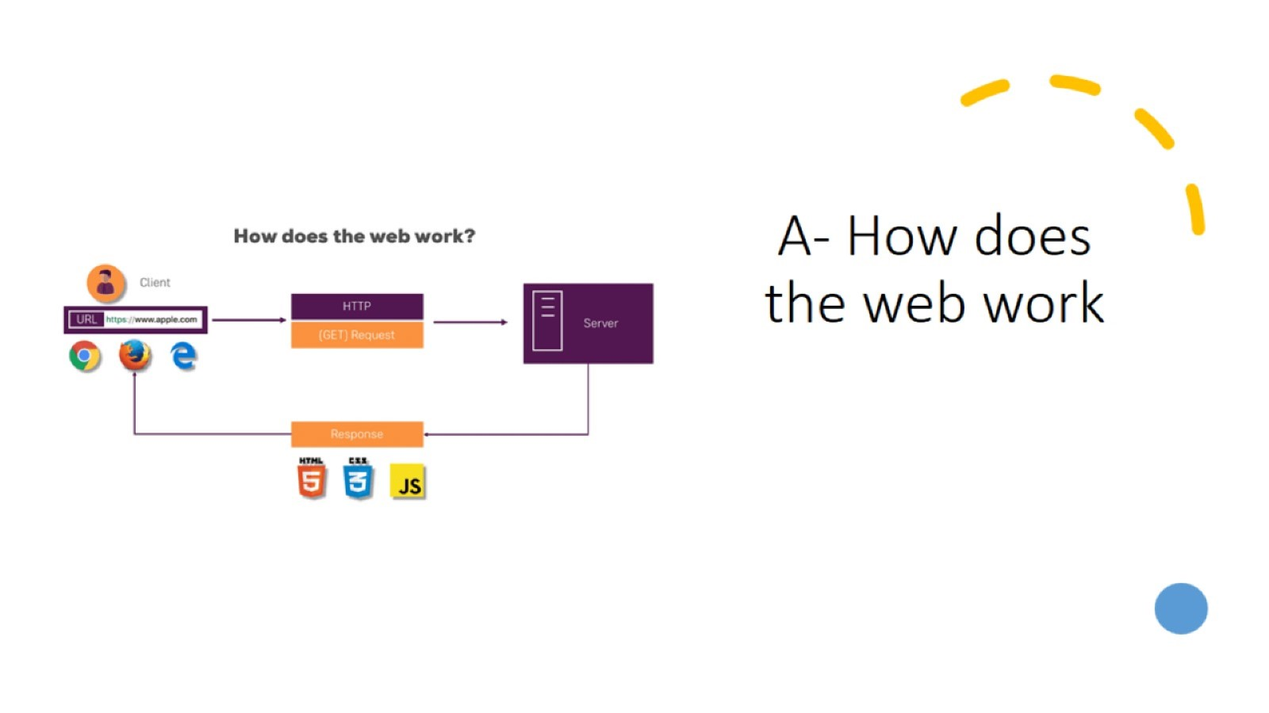
A- How does the web work

Slide 3
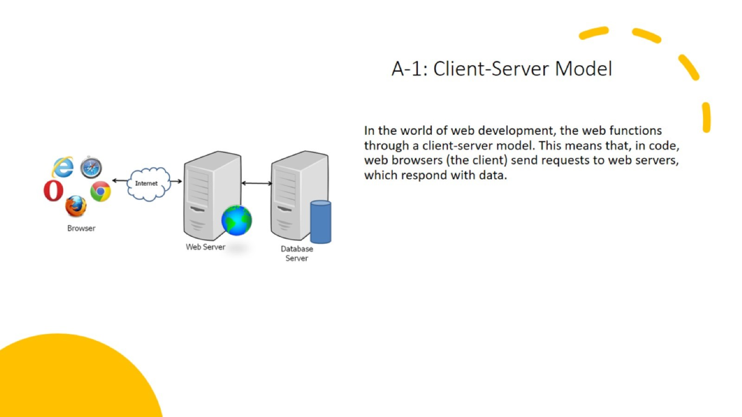
A-1: Client-Server Model

Slide 4
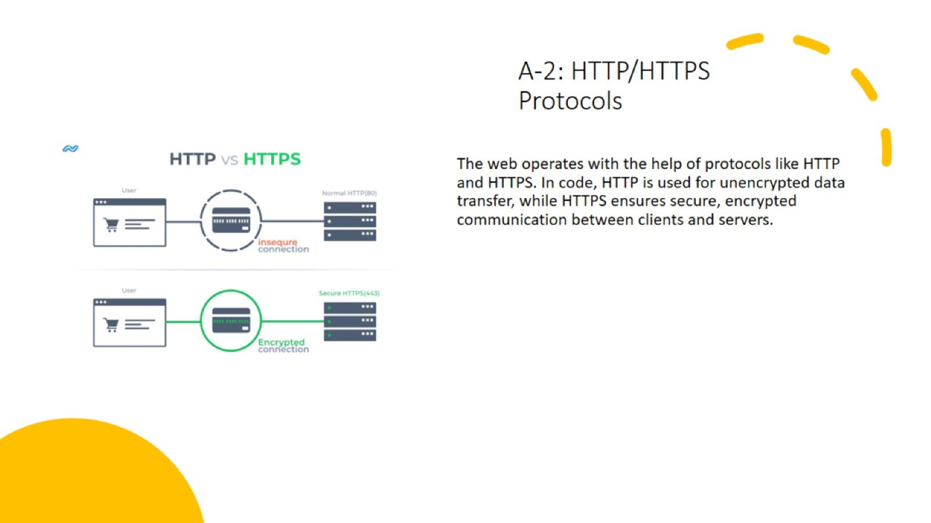
A-2: HTTP/HTTPS Protocols

Slide 5
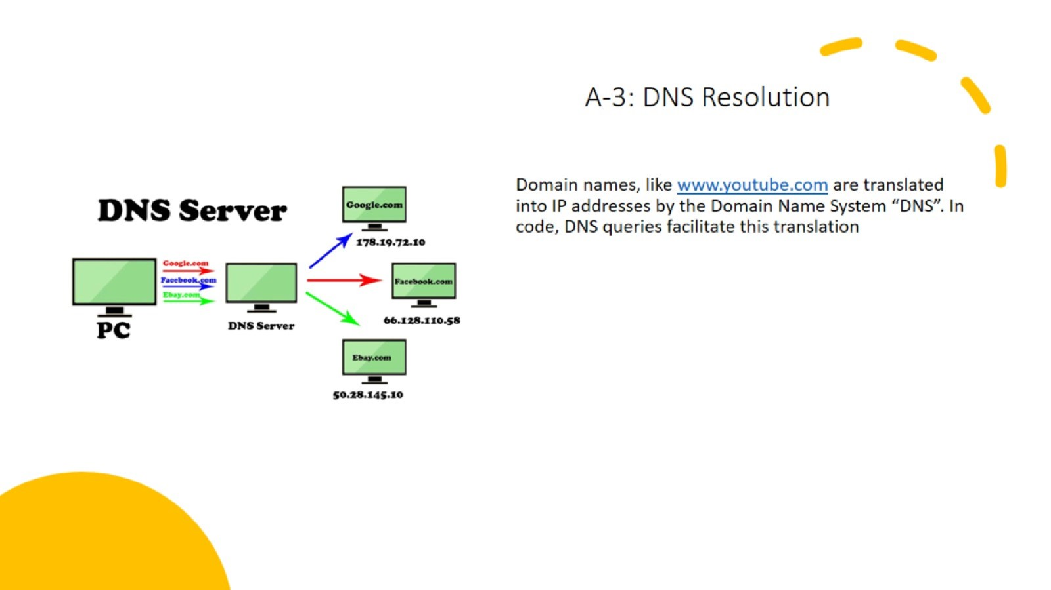
A-3: DNS Resolution

Slide 6
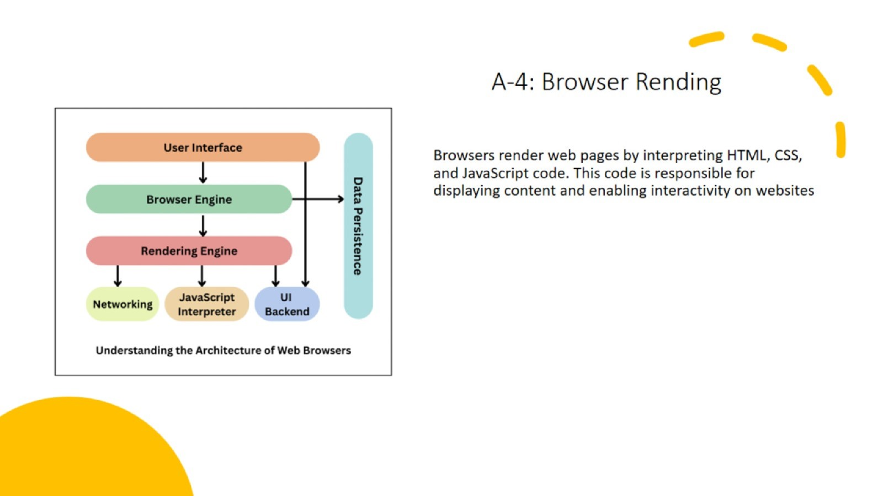
A-4: Browser Rending

Slide 7
A-4: Browser Rending

Slide 8
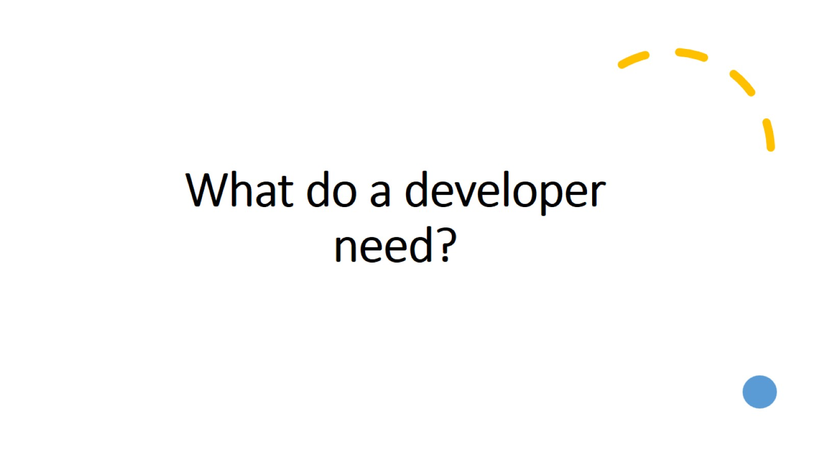
What do a developer need?

Slide 9
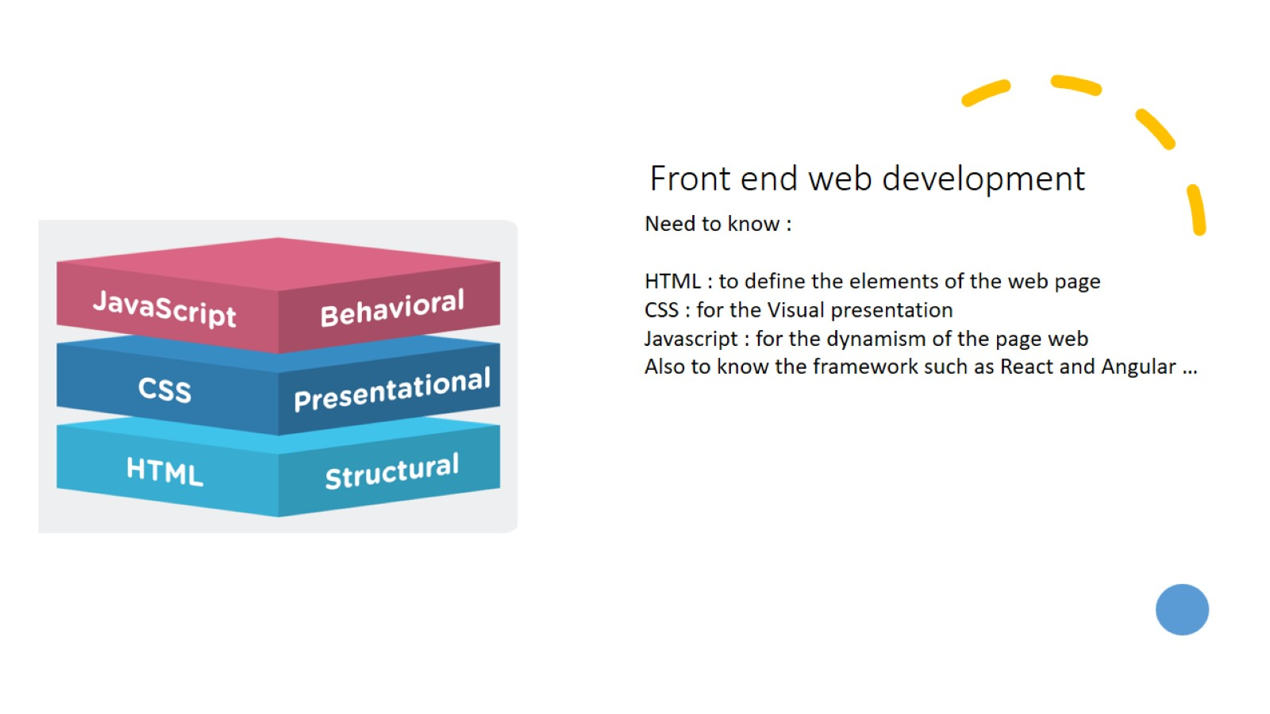
Front end web development

Slide 10
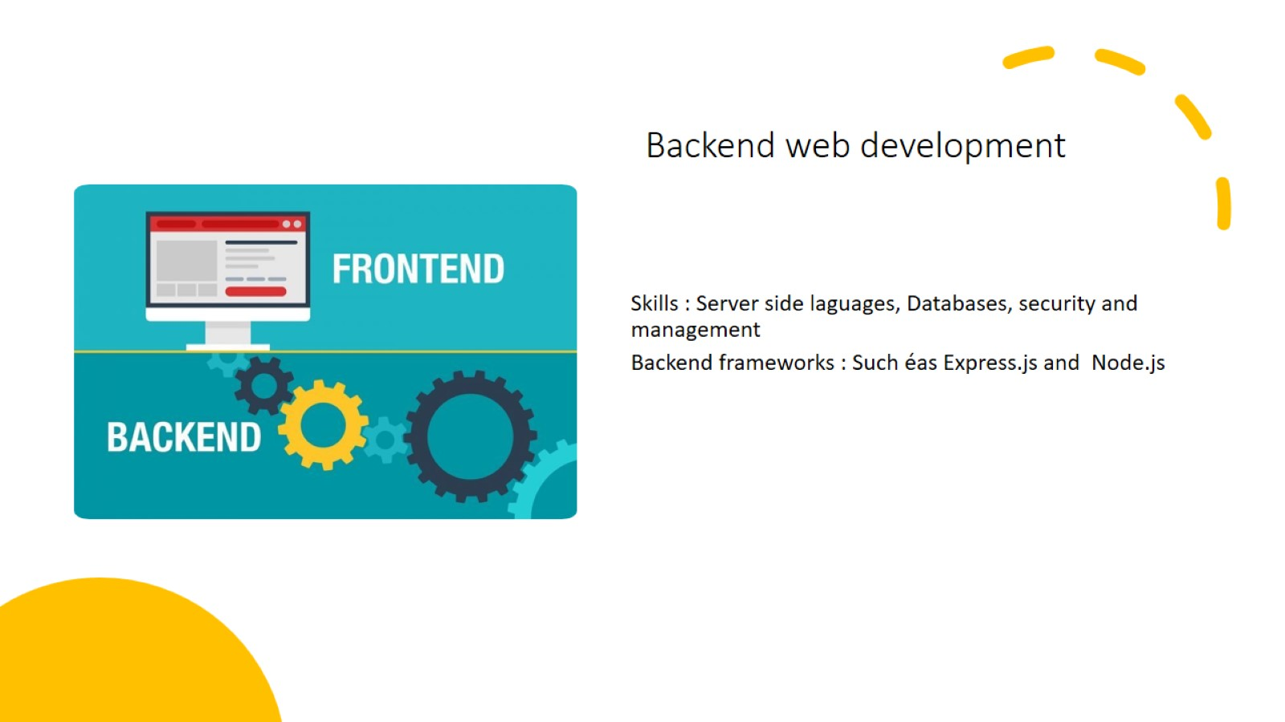
Backend web development

Slide 11
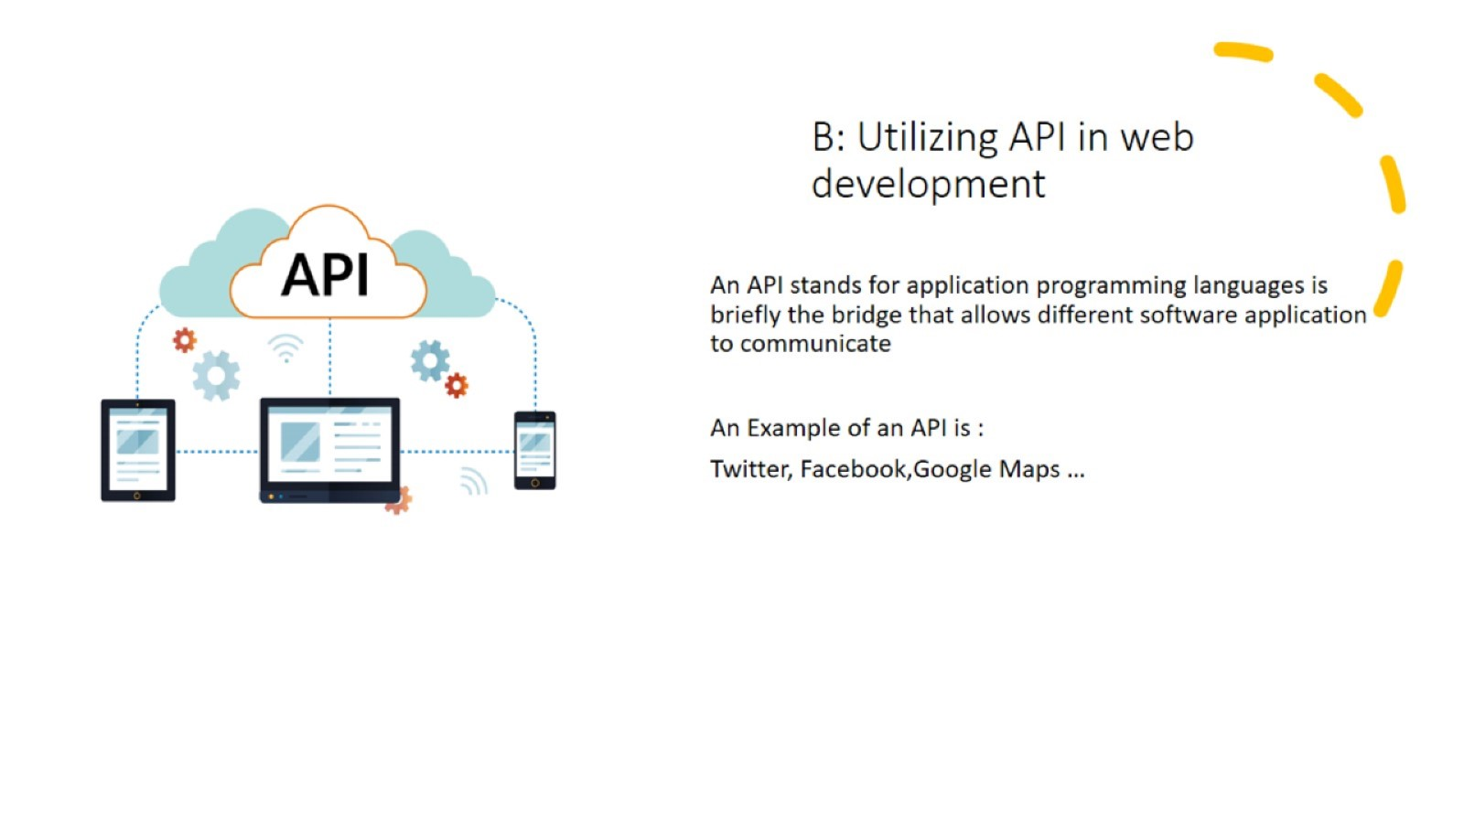

Slide 12
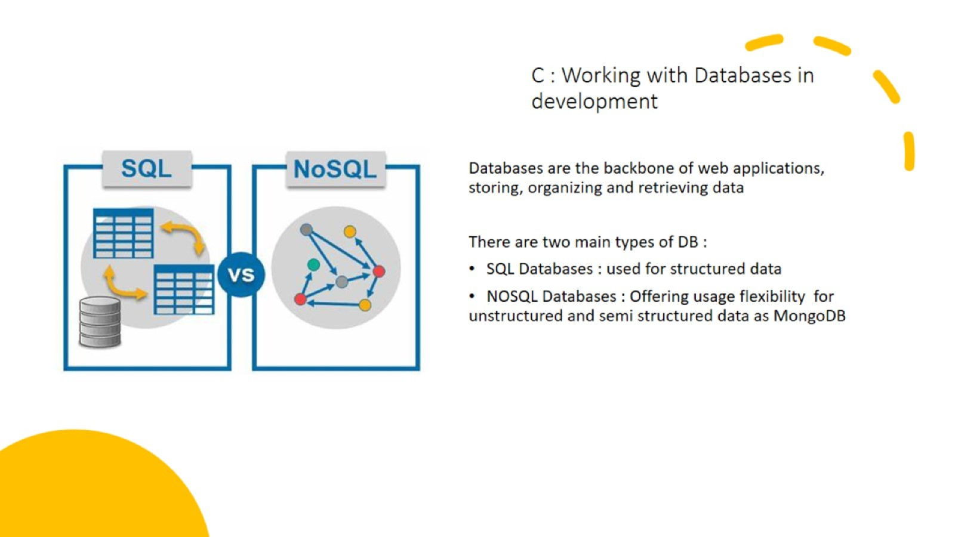

Slide 13
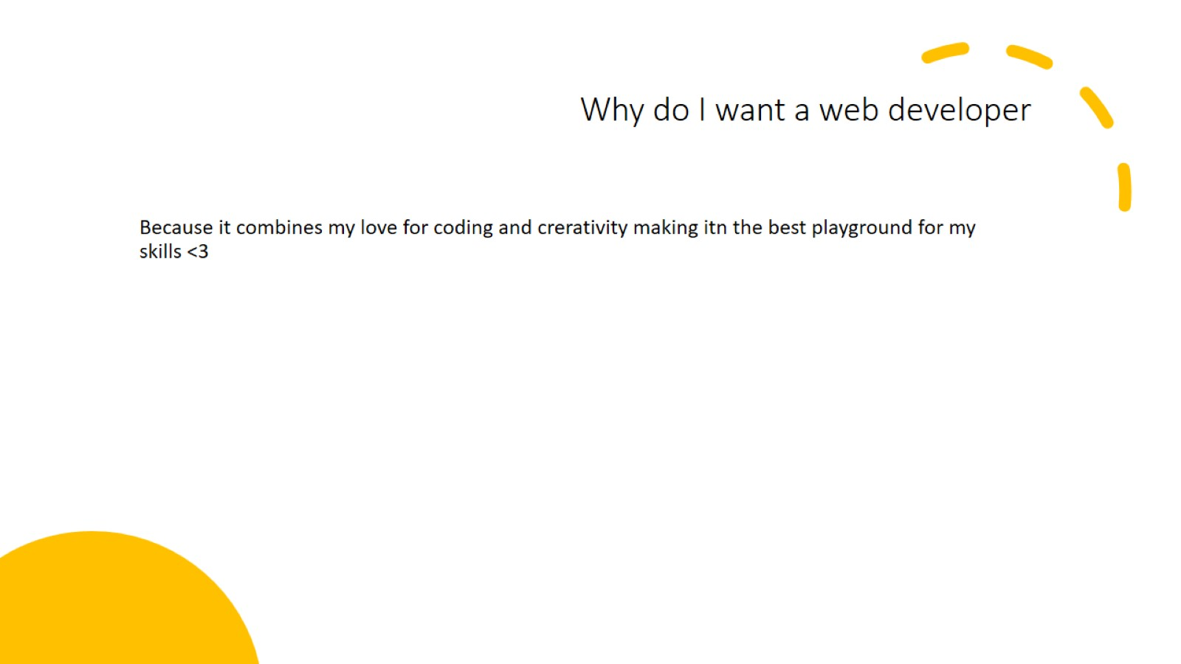
Why do I want a web developer

Slide 14


